Slide 1

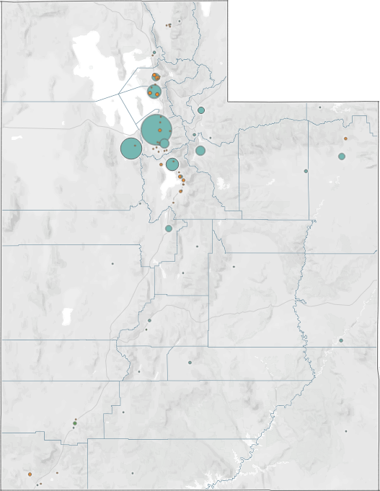
Utah’s Unpaid Meal Debt
2017-2020

Slide 2
September 1, 2020
This research was conducted by Child Nutrition Programs in collaboration with Utahns Against Hunger under the direction of the Utah State Board of Education (USBE).
Tableau workbook available here.

Slide 3
Background

Slide 4
Prior Literature
Nirvi Shah, “Districts Tackling Meal Debt,” Education Week 31, no. 30 (2012): 1-17, link.
Report to Congress: Review of Local Policies on Meal Charges and Provision of Alternate Meals June 2016 (Washington D.C.: USDA, 2016), link.
School Nutrition Operations Report: The State of School Nutrition 2014 (Arlington: School Nutrition Association, 2014), link.
School Nutrition Operations Report: The State of School Nutrition 2016 (Arlington: School Nutrition Association, 2016), link.
School Nutrition Operations Report: The State of School Nutrition 2018 (Arlington: School Nutrition Association, 2018).
School Nutrition Trends Report 2019 (Arlington: School Nutrition Association, 2019), link/.

Slide 5
Historical Context
2007–2009
2009–2011
2010
The ‘Great Recession’ destroys 17.8 trillion in wealth (link) and alters the distribution of wealth in the United States (see increase in Gini index, 2007-2015). There is significant growth of unpaid meal debt in urban and rural areas in the United States (link).
Child poverty in America peaks at 21% (link).

Slide 6
National & Historical Context
2011 2013
2015 2018
The School Nutrition Association (SNA) conducts the first national survey of UPMD. 58% of SFAs report having UPMD at the end of the school year (link), and 65% of state education departments reportedly lack policies to resolve such debt (link). 71% of SFAs report UPMD for the school year. The median UPMD in the survey is $2,000 (link).
76% of SFAs report UPMD for the school year. The median UPMD increases to $2,500 (link).
75% of SFAs report UPMD for the school year. National Median UPMD increases to $3,400 (link). The national average UPMD per district is $19,123 (link).

Slide 7
Data and Methods

Slide 8
Approach—descriptive
Descriptive statistics
Mathematical methods for summarizing information about a sample.
Inferential statistics
Mathematical methods for drawing inferences about a population based on a sample.

Slide 9
Units of Observation
Unit of Observation | Data Source | Observation Years
School Food Authority (SFA) | Data 1011 | 2017, 2029, 2020
District | Data 1053 | 2017, 2029, 2020
Charter | Data 1053 | 2017, 2029, 2020
Residential Child Care Institution (RCCI) | Data 1053 | 2019, 2020

Slide 10
Variables
Variable | Data Source | Observation Years
Meal Debt
Paid Meal Debt | Unpaid Meal Debt Survey, 2020 | 2020
Unpaid Meal Debt (UPMD) Free & reduced debt Full price debt Grades k-6 debt Grades 7-12 debt | Unpaid Meal Debt Survey, 2017 Unpaid Meal Debt Survey, 2020 | 2017 2019, 2020
Student Enrollment
Free & reduced students (F&R) | Data 1063 | 2017, 2029, 2020
Full price (paid) students (FP) | Data 1063 | 2017, 2029, 2020
Longitude and Latitude | Data 1053 (addresses) Texas A&M GeoServices | 2017, 2029, 2020

Slide 11
Sample Data
Sample
Year | Total | District | Charter | RCCI
2017 | 52 | 29 | 23 | 0
2019 | 53 | 25 | 24 | 4
2020 | 53 | 25 | 24 | 4
Count of SFA by type
Note that the sample data are balanced but not symmetrical.
The 2017 survey has no RCCIs and a larger district-to-charter ratio than the 2020 survey.
Population Data
Year | Total | District | Charter | RCCI
2017 | 118 | 41 | 69 | 8
2019 | 133 | 41 | 83 | 9
2020 | 135 | 41 | 85 | 9

Slide 12
Sample Data
Sample
Sum of Enrollment by type
Our sample data comprise 70% of the student population.
Year | Total | District | Charter | RCCI
2017 | 486,298 | 467,104 | 19,194 | 0
2019 | 438,974 | 422,210 | 16,432 | 332
2020 | 441,950 | 245,219 | 16,408 | 323
Population Data
Year | Total | District | Charter | RCCI
2017 | 636,308 | 585,095 | 50,447 | 766
2019 | 662,524 | 600,384 | 61,414 | 726
2020 | 653,170 | 591,037 | 61,516 | 617

Slide 13
Disaggregation by F&R and FP Status
Sample Data
Population Data
2017 | Total | District | Charter | RCCI
F&R | 164,341 | 158,857 | 5,485 | 0
FP | 321,956 | 308,247 | 13,709 | 0
Total | 486,298 | 467,104 | 19,194 | 0
2019 | Total | District | Charter | RCCI
F&R | 216,765 | 200,581 | 15,421 | 763
FP | 419,543 | 384,514 | 35,026 | 3
Total | 636,308 | 585,095 | 50,447 | 766
2019 | Total | District | Charter | RCCI
F&R | 144,301 | 139,416 | 4,533 | 332
FP | 294,673 | 282,794 | 11,897 | 0
Total | 438,974 | 422,210 | 16,432 | 332
2019 | Total | District | Charter | RCCI
F&R | 219,932 | 198,916 | 20,290 | 726
FP | 442,592 | 401,468 | 41,124 | 0
Total | 662,524 | 600,384 | 61,414 | 726
2020 | Total | District | Charter | RCCI
F&R | 141,093 | 136,175 | 4,595 | 323
FP | 301,093 | 289,044 | 12,364 | 0
Total | 441,950 | 425,219 | 16,408 | 323
2020 | Total | District | Charter | RCCI
F&R | 210,521 | 189,290 | 20.621 | 610
FP | 443,200 | 401,747 | 41,446 | 7
Total | 653,170 | 591,037 | 61,516 | 617

Slide 14
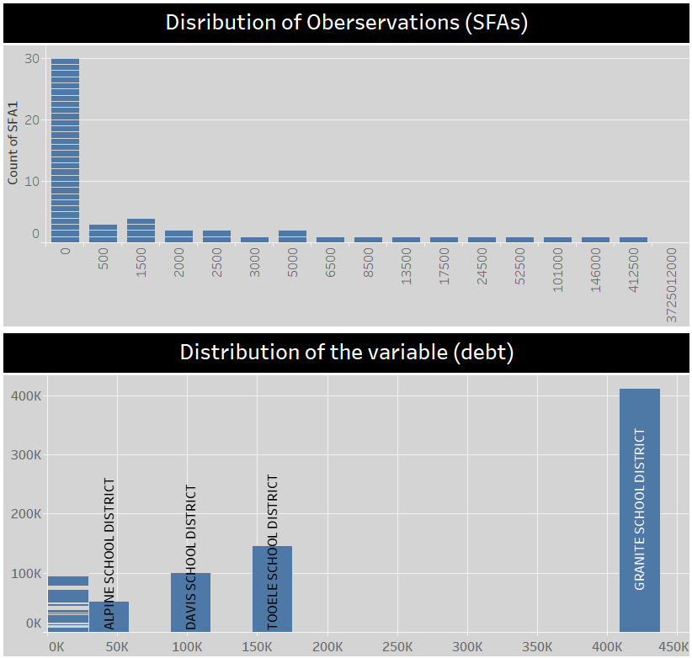
Distribution
The distribution of data is not normal, that is, not ‘bell-shaped’.
The distribution is right-skewed., meaning the mean is to the right of the median.
Most SFAs are clustered on the left around zero debt, dragging the median to the left.
Most debt is concentrated on the right, dragging the mean to the right.
Result: There is a high variance—debt is spread out far from the mean.

Slide 15
Findings

Slide 16
Snapshot
2017
46 or 88% of SFAs reported unpaid meal debt.
71% of unpaid debt was FP debt.
29% of unpaid debt was F&R debt.
2019
27 or 51% of SFAs reported unpaid meal debt.
80% of unpaid debt was FP debt.
19% of unpaid debt was F&R debt.
2020
29 or 55% of SFAs reported unpaid meal debt.
81% of unpaid debt was FP debt.
18% of unpaid debt was F&R debt.

Slide 17
From 2019 to 2020 . . .
Overall unpaid meal debt rose by 24%.
23 or 44% of SFAs reported an increase in UPMD.
SFAs averaged a 15% increase in UPMD.
9 or 17% of SFAs saw a decrease in UPMD.
21 or 40% of SFAs saw no change.
Of the SFAs that saw no change, 20 or 38% had zero debt both years.

Slide 18
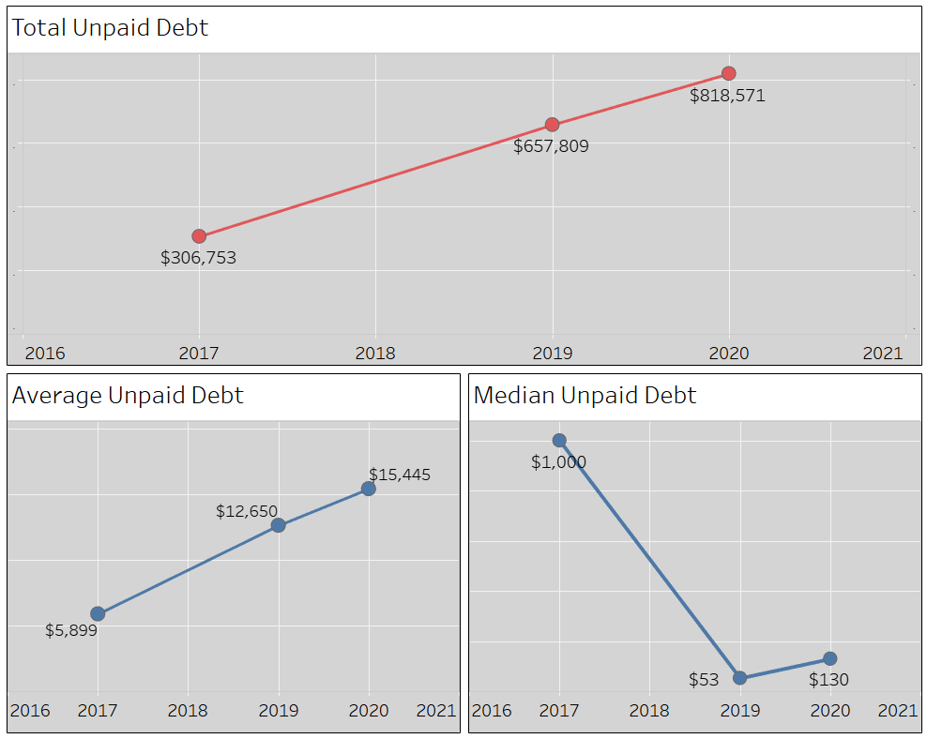
The decline in median debt is the result of debt becoming highly concentrated over the period of observation.

Slide 19
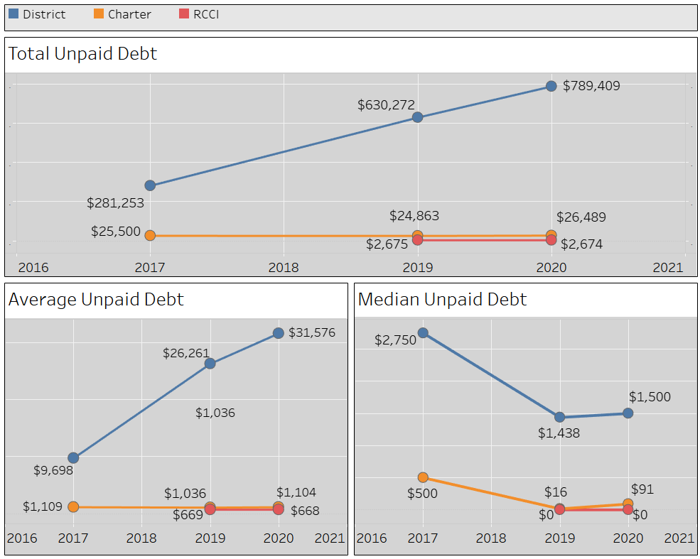
Trends in total unpaid debt, average unpaid debt, and median unpaid debt by classification:
District
Charter
RCCI

Slide 20
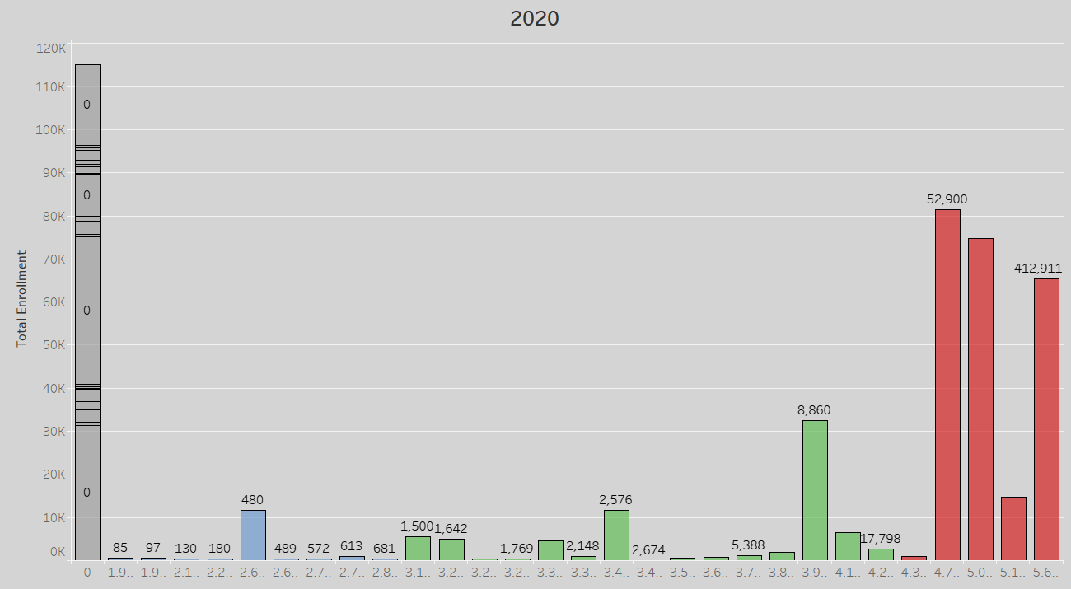
Cluster Analysis

Slide 21
Three tiers of debt:
Tier 1
Tier 2
Uintah SD
Weber SD
Syracuse Academy
Ogden Prep
Venture Academy
Treeside Charter
Havenwood Academy
Box Elder SD
Lakeview Academy
Endeavor Hall
Park City SD
Logon SD
Tier 3
Piute SD
George Washington
Itineris Early College
Ogden SD
Fast Forward Academy
Ogden SD
Wasatch Peak
CS Lewis Academy
Northstar Academy
Bonneville Academy
Granite SD
Tooele SD
Davis SD
Alpine SD
No Summit SD
Juab SD

Slide 22
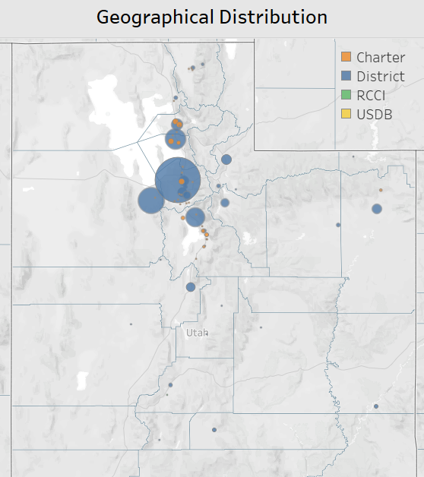

91% of Utah’s UPMD is concentrated in a handful of districts along the Wasatch Front:
Granite School District
Tooele School District
Davis School District
Alpine School District
No Summit School District

Slide 23
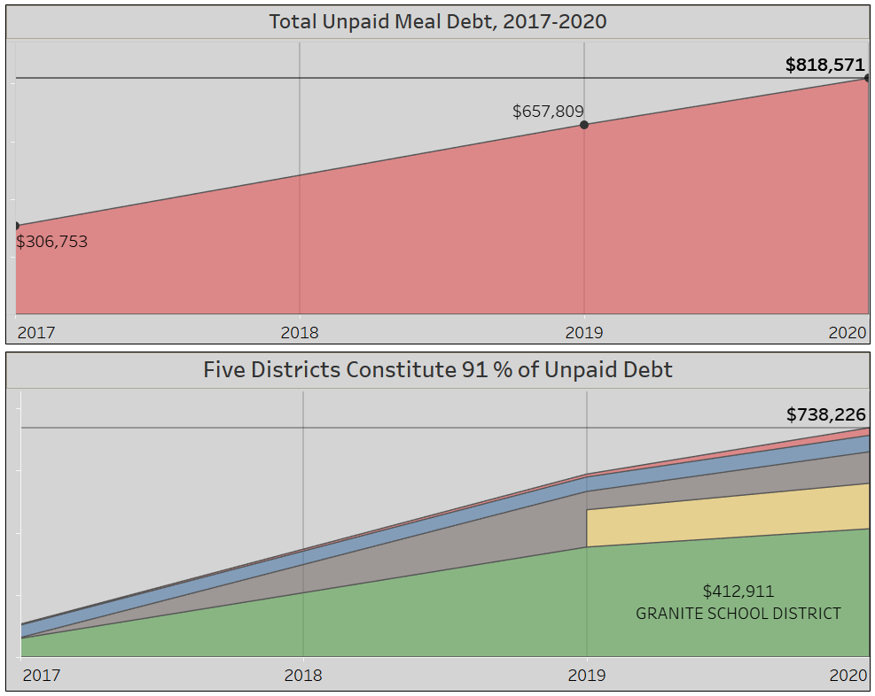
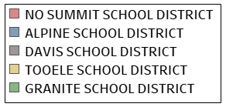
Debt Structure
These districts are responsible for 77% of the growth in unpaid meal debt from 2017-2020.
t

Slide 24
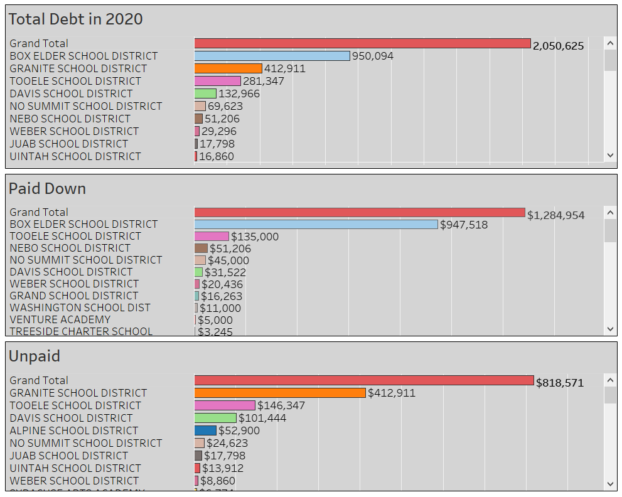
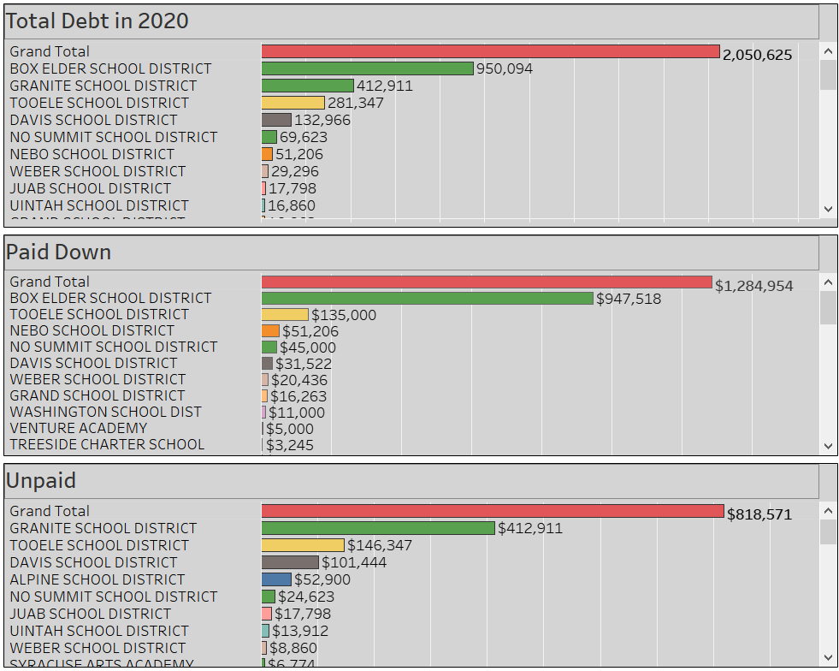
How much debt did SFAs pay down in 2020?
Models for Success?
Box Elder $947,518 / 950,094
Nebo $51,206 / 51,206
Grand $16,263 / 16,263
Points of Contrast:
Granite $0 / 412,911
Alpine $0 / 52,900

Slide 25
Granite SD Policy (link)
(Granite has implemented new meal debt policies for SY 2021)
Students will not be denied meals due to inability to pay.
(New) Schools send out low balance notices prior to students needing to charge.
(New) Schools use automated calls and emails to notify parents of negative balances.
School nutrition departments are instructed to ascertain if a school meal application is appropriate for the student in question.
Collection practices are not specified.

Slide 26
Box Elder SD Policy (link)
Students whose families receive benefits from SNAP, FEP, or FDPIR are automatically eligible for free meals.
Schools will notify parents weekly (and students when appropriate) when the account is in the negative.
In the absence of payment arrangements, students with a negative balance will receive alternative meals.
Schools are to contact parents at least 48 hours before a student is to be given an alternative lunch.

Slide 27
Box Elder Policy Continued
Schools are authorized to send accounts to collections:
That have a negative balance of $35 or more;
No less than two weeks after parents have been notified of the delinquent account either through personal communication or certified letter.
Secondary students (grades 6-12) may be denied lunch once their account has been sent to collections.
Schools will notify students at least 24 hours in advance before lunch is to be denied.

Slide 28
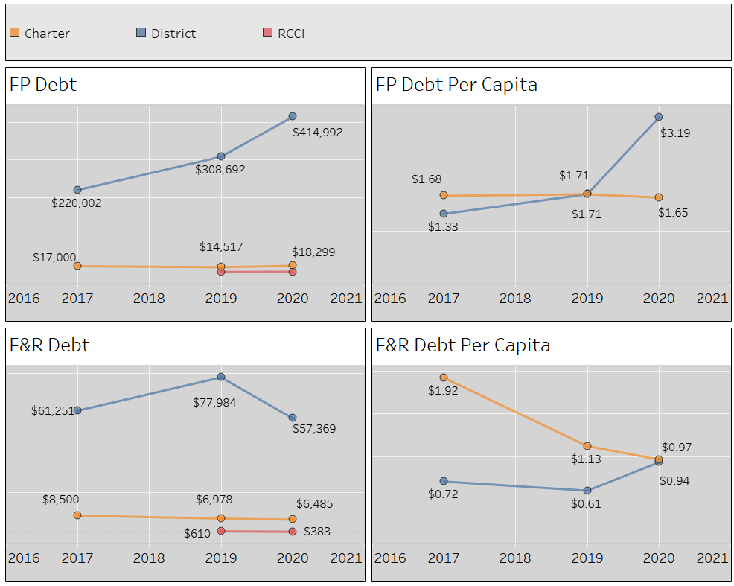
From 2017-2020, three out of four measures show a decline in charter school debt.
Meanwhile, three out of four measures show an increase in district debt.

Slide 29
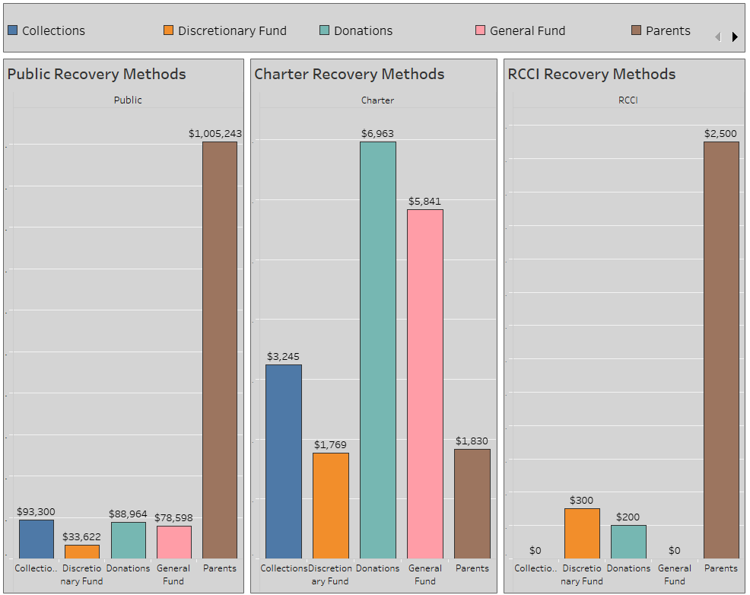
Recovery Methods

Slide 30
Input From Food Service Coordinators

Slide 31
Role of Policy
We have a policy in place that helps keep our balances very low. ~Melanie Miller, Ogden School District
More support from the superintendent to support a better negative balance policy. ~Marni Shepherd, Juab School District
New policy has helped a ton. ~Jodi Lum, Lincoln Academy
We now have a policy in place for negative balances. This has helped keep balances low. ~ Sheri Sear, Bonneville Academy

Slide 32
Role of Staff
The previous director did not spend as much time encouraging families to complete free and reduced applications. ~Alysha Packard, Grand School District
We have become more proactive about early contact. ~ Paula Masterson, NorthStar Academy
We have started checking qualifying children for siblings. ~Jeneane Warren, Emery School District
We have a person who calls and emails parents. ~Sharleen Breese, Summit Academy
Daily reminders for parents. ~Paula Loveland, Iron School District
We collect before the end of the school day. ~Laura Adams, Garfield School District

Slide 33
End

